Slide 1
Part Engineering
Notes:
Part engineering is the aggregation of protein, promoter, RNA engineering, and the like. Sometimes a genetic device can only be concretized by the addition of a non-natural biochemical component, and for such applications one must apply part engineering to generate a synthetic part.

Slide 2
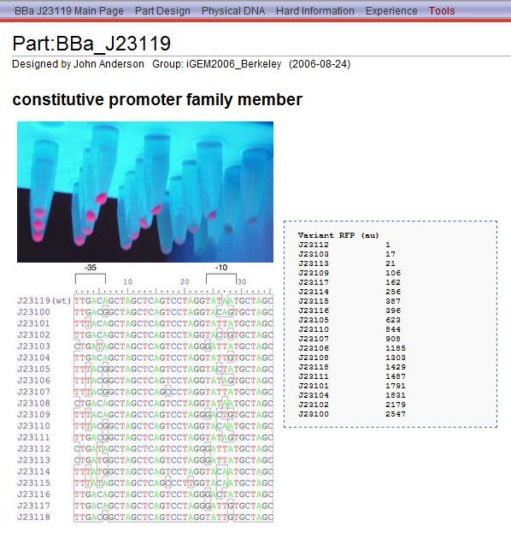
Promoter Families
Notes:
One trivial example of Part engineering is the generation of constitutive promoters and ribosome binding site parts. We have discussed these types of parts and their use in previous chapters. In this example, a combinatorial library was used to generate a family of constitutive promoters that vary in strength over three orders of magnitude. However, today we are discussing the more advanced applications of part engineering where more complicated biochemical functions are required. Examples include enzymes whose substrate specificity is altered, RNAs that bind to small molecules, or transcription factors that site-selectively bind user-defined DNA sequences.

Slide 3
Integration of parts and devices
Although there aren’t many examples, a frontier in synthetic biology is the integration of part engineering (promoters, proteins, RNAs) and device engineering
Part engineering is very different from device engineering
Libraries and/or 3D modeling are the essential tools used
Most part engineering is for making purified protein products, like engineered therapeutic proteins or enzymes
Large body of literature around engineering RNAs, a fair amount on promoters, and rare examples of other types of parts
It is a much older and more extensive literature than devices
Device engineering is used to make genetic selections for screening through large combinatorial libraries of parts
Engineered parts can be combined with other parts to make new devices
Notes:
There are very few examples in the literature of the integration of part engineering and device engineering. Though protein engineering is a large topic, it is rare to construct multi-gene devices and also include an engineered part.
Part engineering is very different from device engineering. It deals with issues of three dimensional structure and the chemical details of intermolecular interactions rather than networks of molecules. As a result, the tools and approaches are quite different.
Typically, combinatorial or directed evolution approaches using mutant libraries are required for this type of engineering. There are more directed approaches using computational tools and design strategies. Often these tools will be used in conjunction with library strategies.
Most part engineering is for making purified protein products, such as engineered therapeutic proteins or enzymes
There is also a large body of literature around engineering RNAs, a fair amount on promoters, and rare examples of other types of parts such as origins of replication
This type of engineering was popular before multi-gene device-style engineering, and thus there is an older and more extensive literature around protein and RNA engineering than around device engineering
The intersection of parts engineering and device engineering shows up in two areas. Device engineering is used to make genetic selections for screening through large combinatorial libraries of parts,
And engineered parts can be combined with other parts to make new devices

Slide 4
Unnatural Amino Acids
Notes:
The site-specific incorporation of unnatural amino acids into proteins in live cells was demonstrated by Schultz and coworkers in the early 2000’s. This methodology has been expanded upon greatly since that time. These systems are a examples of the integration of part and device engineering as well as the use of device engineering to construct genetic selections.

Slide 5
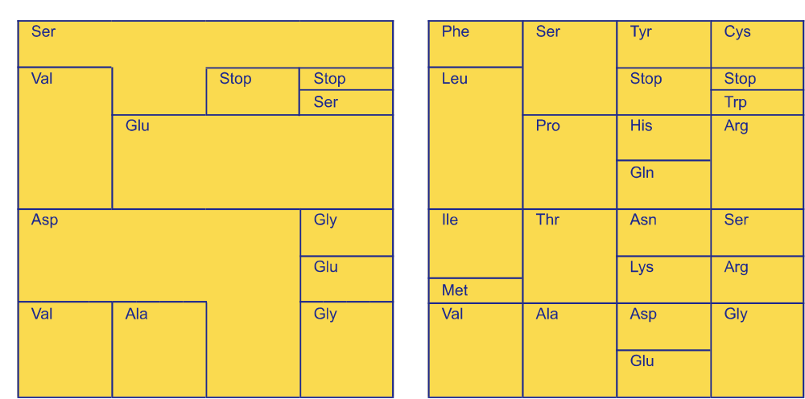
The Evolving Genetic Code
Notes:
Though we are accustomed to thinking of the genetic code as something universal and static, not all organisms today share the exact same code. For example, Mycobacteria use UGA codons to encode tryptophan instead of stop. Additionally, early life is believed to have had a simpler genetic code such as this one at left. This raises the question, what determines the specificity of the genetic code, and can it be expanded to encode more amino acids?

Slide 6

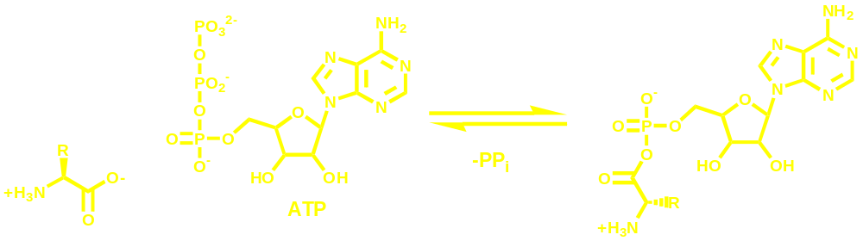



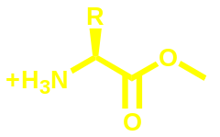


Aminoacyl-tRNAs and Synthetases
Amino Acid Adenylate
(in complex with synthetase)
86 tRNA genes in E. coli
About 50 processing and base modification genes
21 aa-tRNA synthetases
Several deacylation enzymes
Notes:
The genetic code is determined by enzymatic interactions between the tRNAs, amino acids, and aminoacyl-tRNA synthetases in the cell. There are 86 tRNA genes in E. coli, and thus there are more tRNAs than there are codons. Thus there is not a simple one-to-oneness about the decoding of mRNAs. Additionally, there are around 50 processing and base modification genes that further change the chemical identity of these tRNAs. There are 21 aa-tRNA synthetases, just one more than the number of proteinogenic amino acids, and there are several deacylation enzymes which can reverse the reaction of a synthetase. Thus, there are a large number of substrates and enzymes that all must interact precisely to retain the specificity of the code. Primarily this specificity is encoded by the specifity of the synthetases which must specifically recognize their own tRNAs and amino acids, and avoid all others.

Slide 7
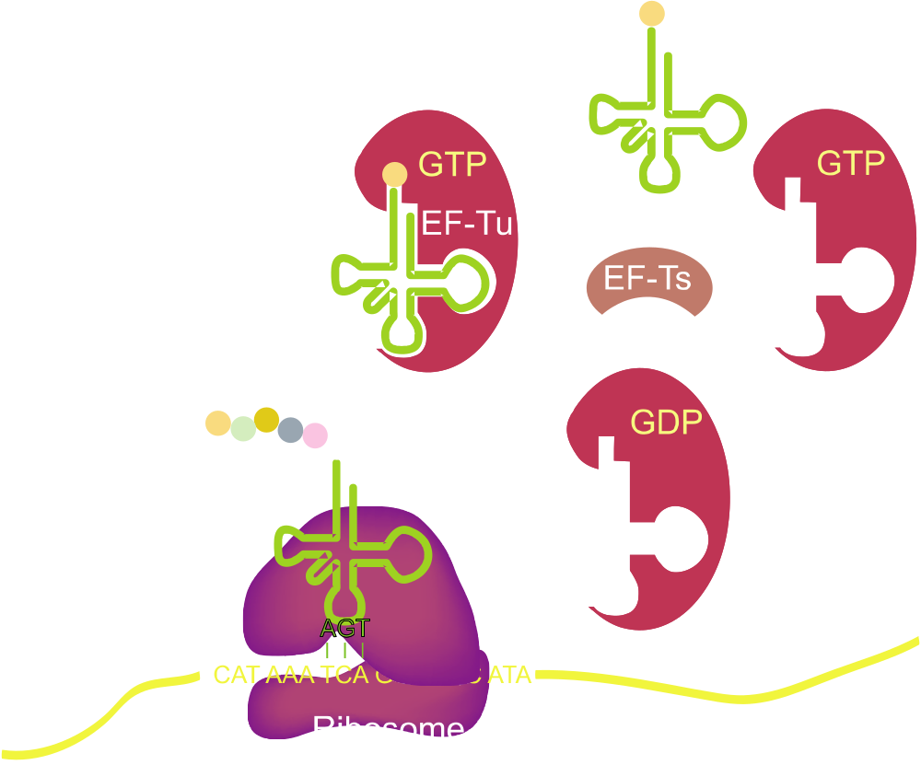
Incorporation into Protein
22 rRNA genes
At least 85 ribosomal protein genes
At least 12 elongation and initiation factors
Notes:
Once a tRNA is aminoacylated with an amino acid, little additional editing is done by the downstream enzymes. There are 22 rRNAs, 85 ribosomal proteins, and around 12 elongation and initiation factors associated with translation, but once a tRNA is aminoacylated, that amino acid will get incorporated into protein in response to whatever codon exists on the tRNA. There is some editing by EF-Tu for mismatched pairings of tRNA and amino acid, but most charged tRNAs are accepted by this molecular machinery.

Slide 8

A 21st Orthogonal Pair
SerRS
PheRS
MetRS
LeuRS
UaaRS
AGU
AAA
UAC
GAG
AUC
UCA
UUU
AUG
CUC
UAG
Notes:
The specificity of translation is around 1 in 10,000, and this is primarily determined by the synthetases. Thus there exist 20 parallel but orthogonal pathways for aminoacylation in the cell.
*
Leucyl synthetases exclusively charge with leucine while avoiding similarly-structured amino acids. Similarly, all the other synthetases will ‘avoid’ charging leucine.
*
Similarly, the synthetases must specifically recognize their own tRNAs. The seryl synthetases only charge seryl tRNAs and so forth.
*
Additionally there is orthogonality with the recognition of codons. The ribosome will distinguish similar sequence codons and only employ proper matches.
*
Thus, if one wishes to add an additional amino acid to the code without interfering with normal translation, one must identify a codon that can be encoded, a tRNA that specifically decodes that codon while only being charged by an added synthetase, and that synthetase must only charge the unnatural amino acid. Essentially, this boils down to identifying a pair of tRNA and synthetase that are orthogonal to the others in that organism and specific for an unnatural amino acid. Making tRNAs and synthetases entirely de novo or by computational approaches is well beyond the scope of these tools even today. Thus, it requires protein engineering strategies based on existing enzymes that are close in function to the specification. Thus, other organisms tRNAs and synthetases were examined for suitability.

Slide 9
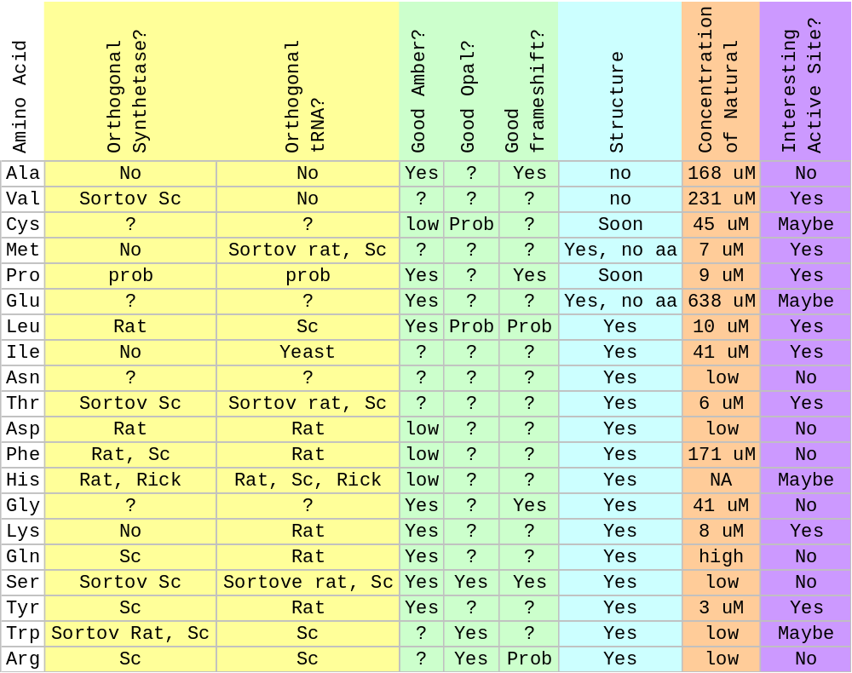
Considerations for Orthogonal Pairs
Notes:
At the time these studies were performed, this is an ensemble of the knowledge that was known about potential tRNA/Synthetase pairs. There are 20 proteinogenic amino acids that are common. There are a few others such as selenocysteine and pyrollysine that occur in some organisms, but much of the natural diversity works with the common 20. Thus, it is highly unlikely that a natural synthetase would accept an unusual unnatural amino acid such as one containing an azide or fluorophore. The altered amino acid specificity is something that must be engineered into the synthetase later. Thus, we must first pick which amino acids to target. The first question is whether there is evidence that a tRNA and synthetase for one of the amino acids will be orthogonal to the recipient organism. Though the biochemical data is sparse, there have been cross-species aminoacylation studies for yeast, rats, some bacteria, and human biomolecules. It must also be the case that the tRNAs for that amino acid can be modified to read another codon in the cell. Of these, the options are nonsense suppression (which means decoding TGA or TAG stop codons) or frameshift suppression (decoding 4-base codons and shifting the frame). The challenge here is that many synthetases use the codon itself to recognize their cognate tRNAs and modification of this region will often render the molecule inactive as a substrate. Since there must be protein engineering to alter the amino acid specificity, there would need to be a crystal structure. Another consideration would be the cellular concentration of the amino acid. Some, like glutamate are almost millimolar in the cell while others are low micromolar. It would be challenging to engineer a synthetase to recognize amino acids similar in structure to glutamate while maintaining specificity. Finally, the active site needs to be able to accept a new substrate. Mechanistically, some active sites use the backbone to recognize the amino acid, and in such cases backbone substitutions alone cannot change their specificity. Thus, some amino acids are likely to be workable more than others, and in practice Tyrosine was the best candidate and also the first successful system. Several others, including Tryptophan, lysine, and leucine have since been demonstrated to work as well.

Slide 10
A 21st Orthogonal Pair
SerRS
PheRS
MetRS
LeuRS
UaaRS
AGU
AAA
UAC
GAG
AUC
UCA
UUU
AUG
CUC
UAG
Notes:
The orthogonal synthetase must not recognize any of the native tRNAs in the organism. If it did, the unnatural amino acid would be incorporated into native proteins, and this would be lethal to the cell. It is fairly easy to test this in vitro. There are kits for preparing total tRNA from cells, and synthetases usually can be expressed recombinantly in E. coli. Also, there are fairly easy radioactive labeling assays for monitoring these reactions. Thus, one can easily ask whether any given synthetase aminoacylates any of the tRNAs of a given cell type.

Slide 11
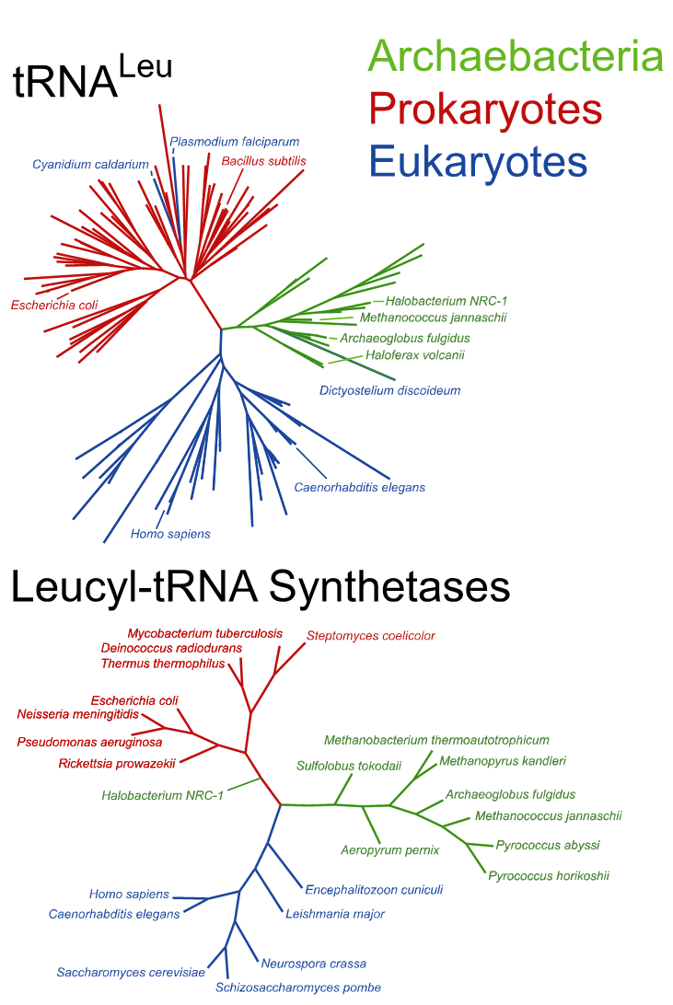
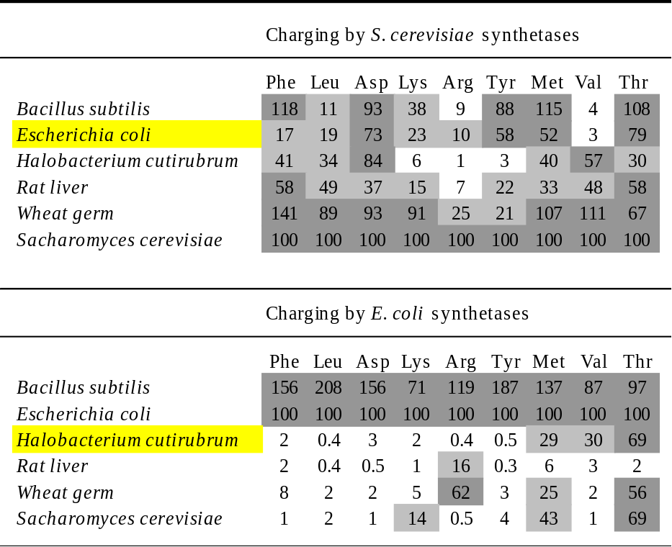
Cross-species aminoacylation
From Kwok, Y.; Wong, J. T. Can. J. Biochem. 1980, 58, 213-218.
Notes:
There were several of these studies done in the 1970’s which showed that usually prokaryotic tRNAs cross react with prokaryotic synthetases, but eukaryotic and archaeal synthetases are sometimes orthogonal to prokaryotic tRNAs. If you examine the phylogenetic trees for tRNA and synthetase genes, you’ll see tight clades associated with the different kingdoms. The archaebacteria in particular turned out to be a fruitful area for investigation. Halobacteria are one particular genus of archaebacteria that are growable under normal lab conditions and have tRNAs similar to the other arachae. Thus, most of these specificity studies on archael synthetase are examined on halobacterial tRNA.

Slide 12
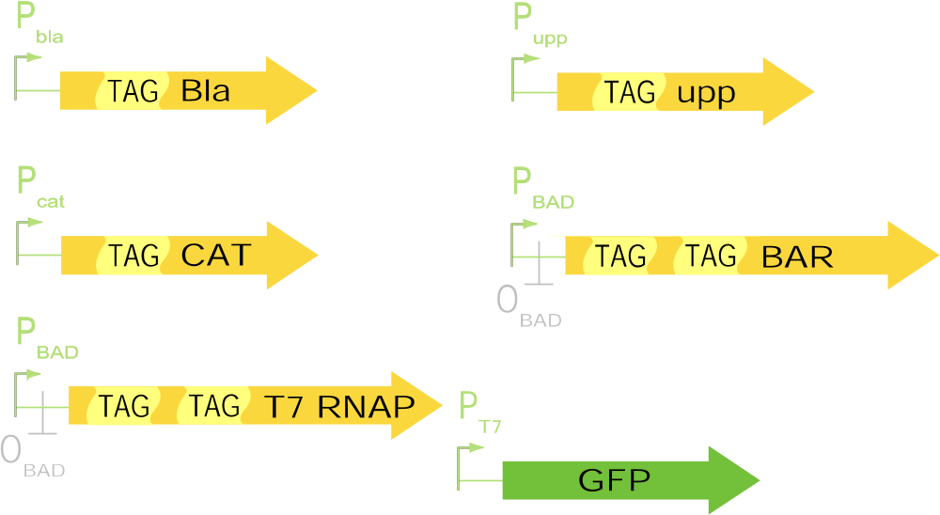
Reporter Genes in vivo
Resistance to Ampicillin
Sensitivity to 5-Fluorouracil
Resistance to Chloramphenicol
Toxic protein barnase, Sensitivity to Arabinose
Green Fluorescence with UV Irradiation
Notes:
The remaining interactions are best studied in vivo using genetic circuits. Because there are so many uncharacterized tRNA modification reactions, it is unrealistic to prepare pure samples of orthogonal tRNAs. One can produce tRNAs in vitro runoff transcription, but such data turns out not to be predictive of in vivo behavior, presumably due to base modifications or other subtle aspects of tRNA recognition by EF-Tu or the ribosome. Thus, the specificity of an orthogonal tRNA is best observed in vivo. The easiest codon to recode in E. coli and yeast is the UAG or amber stop codon. If you place a UAG stop codon into a reporter gene such as an antibiotic resistance marker, it will cause premature termination and a non-functional protein product. If a tRNA exists in the cell that can recode TAG as a sense codon, and this tRNA gets aminoacylated, then the gene’s function is restored. The term for such a tRNA is a suppressor tRNA, and these occur through spontaneous mutation, but can also be caused deliberately by mutating anticodons to CUA. Several of these selection systems have been developed allowing researchers to quantify the degree of recoding in the cell. There were conditional positive selectable reporters such as b-lactamase and chloramphenicol acetyltransferase, and conditional negative selections such as upp and barnase. Additionally, there were genetic circuits that could amplify the effect of the suppression in activation of a GFP reporter.

Slide 13
A 21st Orthogonal Pair
SerRS
PheRS
MetRS
LeuRS
UaaRS
AGU
AAA
UAC
GAG
AUC
UCA
UUU
AUG
CUC
UAG
Notes:
The critical requirement for the orthogonal tRNA is that it not be charged by the native synthetases. Thus, in a cell that lacks the orthogonal synthetase, this tRNA should be uncharged and not suppress TAG codons. Phenotypically then, a cell with one of these reporter genes and just the orthogonal tRNA gene should be off, but addition of the orthogonal synthetase should turn it back on.

Slide 14
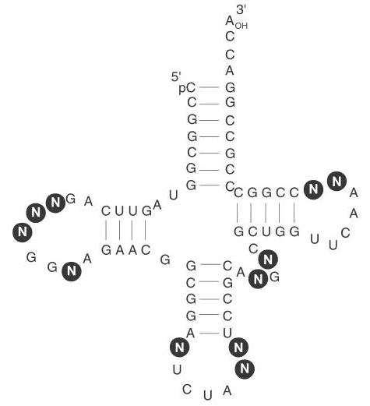
o-tRNAs libraries
PMID: 11564556
Notes:
The reality is that most systems grafted from other organisms do not give clean boolean results like this. There is usually some gradation where some suppression is observed without the synthase, and some higher level is observed with the synthetase. Thus, it was usually necessary to extensively engineer these orthogonal tRNAs to have them operate well. The strategy employed was a combination of targeted mutagenesis and genetic selection. For most tRNA/synthetase pairs, the regions of the RNA sequence that are specificity determinants for the synthase are known. Often this recognition is in the loops and acceptor stem. By remaining unaltered those sites necessary for recognition by the orthogonal synthetase while mutating those positions that often recognized by other synthetases, it is possible to find variants that are specifically charged by just the orthogonal synthetase. These tRNA libraries are generated using combinatorial saturation mutagenesis, and in this case the theoretical diversity is 4^11, or around 4 million variants.

Slide 15
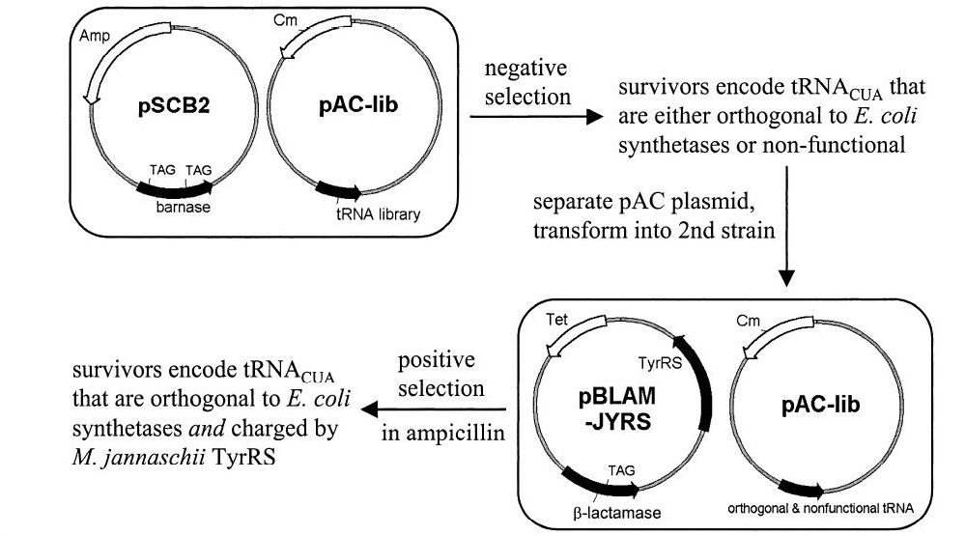
Selection of o-tRNAs
PMID: 11564556
Notes:
That large diversity is screened using genetic selections. First, these tRNAs are subcloned into a plasmid and introduced into cells containing one of the negative selection systems, in this case barnase. If the tRNA is charged by a native synthetase, the codons get suppressed and the cell is killed removing that tRNA from the population. The surviving tRNA-encoding plasmids are then transferred into cells containing a postive selection system and the orthogonal synthetase. If the synthetase still accepts the tRNA, it will be charged, and the cells will survive. The result of this dual selection is enrichment for those tRNAs that are functional for translation in the cell, are tolerated by the synthetase, and avoided by native synthetases.

Slide 16
A 21st Orthogonal Pair
SerRS
PheRS
MetRS
LeuRS
UaaRS
AGU
AAA
UAC
GAG
AUC
UCA
UUU
AUG
CUC
UAG
Notes:
We have now seen two examples of the integration of part engineering and device engineering. Engineered RNAs have been used to construct an orthogonal suppression system, and a genetic circuit was used to perform the selection. The same approach is used to change the specificity of the synthetase towards the unnatural amino acid. One might expect that this is best done with an unnatural amino acid similar in structure to a native one. However, if it is too similar the native synthetase will incorporate the unnatural amino acid and this would kill the cell. Indeed, many unnatural amino acids are toxic to cells. To fix that, one would need to alter the specificity of the native synthetases in addtion to the orthogonal one. In practice, that is unrealistic, but it is easy to test for natively-accepted amino acids by monitoring their toxicity and eliminating any that are incorporated.

Slide 17
A 21st Orthogonal Pair
SerRS
PheRS
MetRS
LeuRS
UaaRS
AGU
AAA
UAC
GAG
AUC
UCA
UUU
AUG
CUC
UAG
Notes:
Changing the specificity of an enzyme is not a common feat of protein engineering. Though there are many examples of relaxing an enzymes specificity, the specification of this system is that the synthetase exclusively accepts the unnatural substrate.

Slide 18
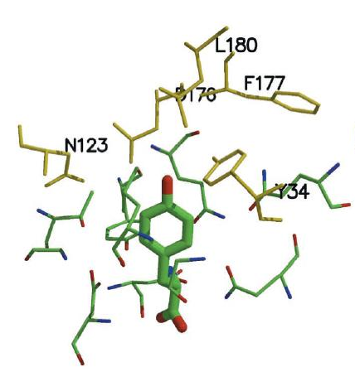
Uaa-Specific Synthetase
PMID: 11313494
Notes:
The approach taken to find altered specificity variants involved saturation mutagenesis of the active site. The first system this was applied to was a tyrosine tRNA/synthetase pair from the archaebacterium methanococcus janasschii. That synthetase was similar in sequence to the bacterial ones, and there was a crystal structural for one of the bacterial variants. In that structure, there is a pocket of residues that recognize the para position of the unnatural amino acid, and these residues were targetted with NNK saturation. Thus, there are 20 possible amino acids at each position, and 5 positions, so 20^5 variants which is around 3 million.

Slide 19
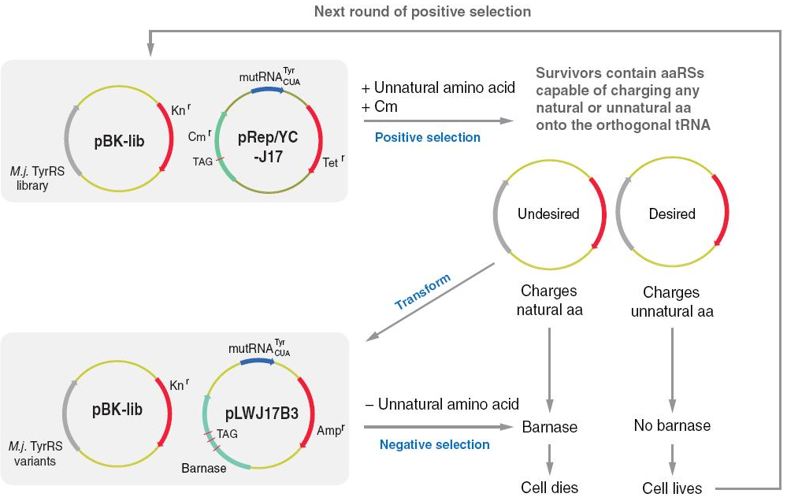
Uaa-Specific Synthetase
PMID: 11313494
Notes:
These synthetase variants were screened using the same basic dual selection used before to improve the orthogonality of the tRNA. Cells are transformed with the library and a reporter construct containing the orthogonal synthetase and a positive selection marker (chloramphenicol acetyltransferse) containing the stop codon. If a cell receives a synthetase specific for the unnatural amino acid or the native amino acid, it will survive selection on chloramphenicol. The extreme majority of the surviving synthetases will be specific for the natural amino acids, but rare variants can be selected by negative selection. Here, the pool of synthetase plasmids that passed the positive selection are introduced into cells containing the orthogonal tRNA and barnase. The unnatural amino acid is omitted from the media, and thus the only active synthetases are ones that still recognize the native amino acid. Those wildtype-like variants will thus kill the cell leaving behind only those synthetases specific for the unnatural amino acid.

Slide 20
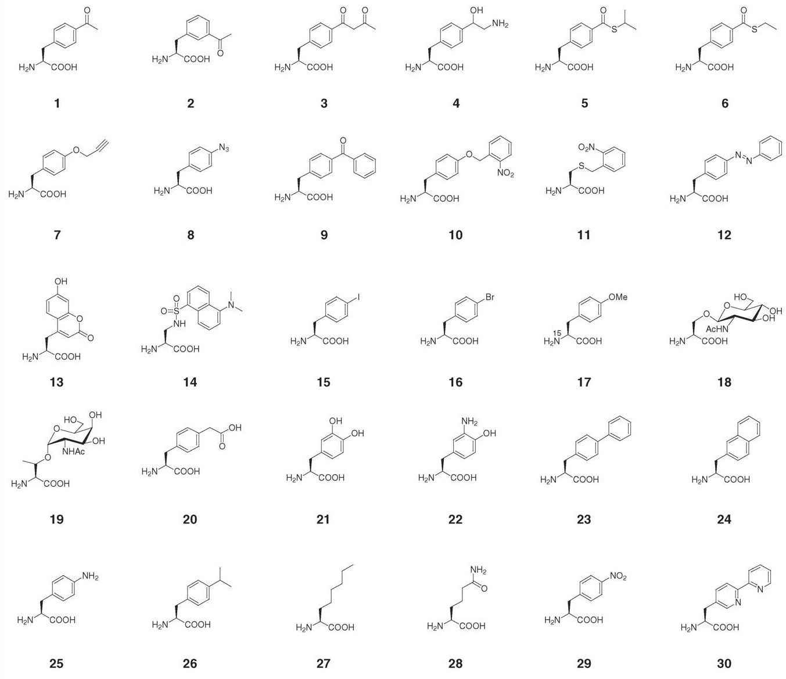
As of 2006…
Notes:
As of 2006, 30 different unnatural amino acids had been incorporated using one of these engineered systems, and that list has continued to diversify.

